Slide 1

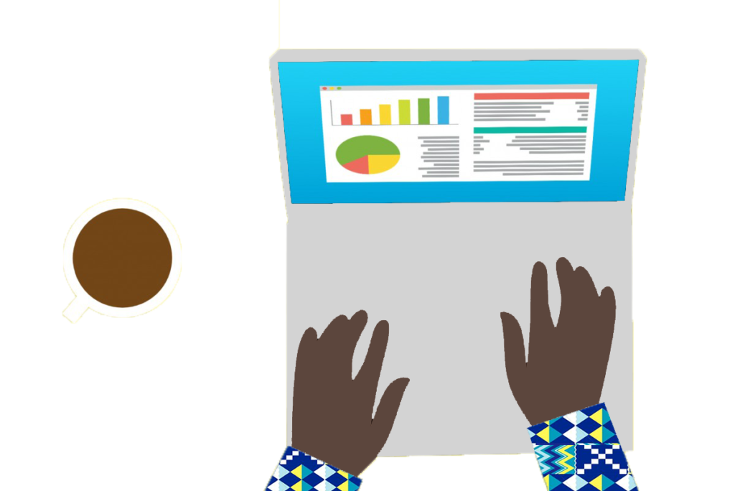
Using LLM APIs in a Spreadsheet
The Graph Courses

